Slide 1
Cost Estimating Best Practices
SAME Tulsa Post Cost Engineering Workshop
Mark A Childs CCP, PMP
19 March 2019
Tulsa, OK

Slide 2
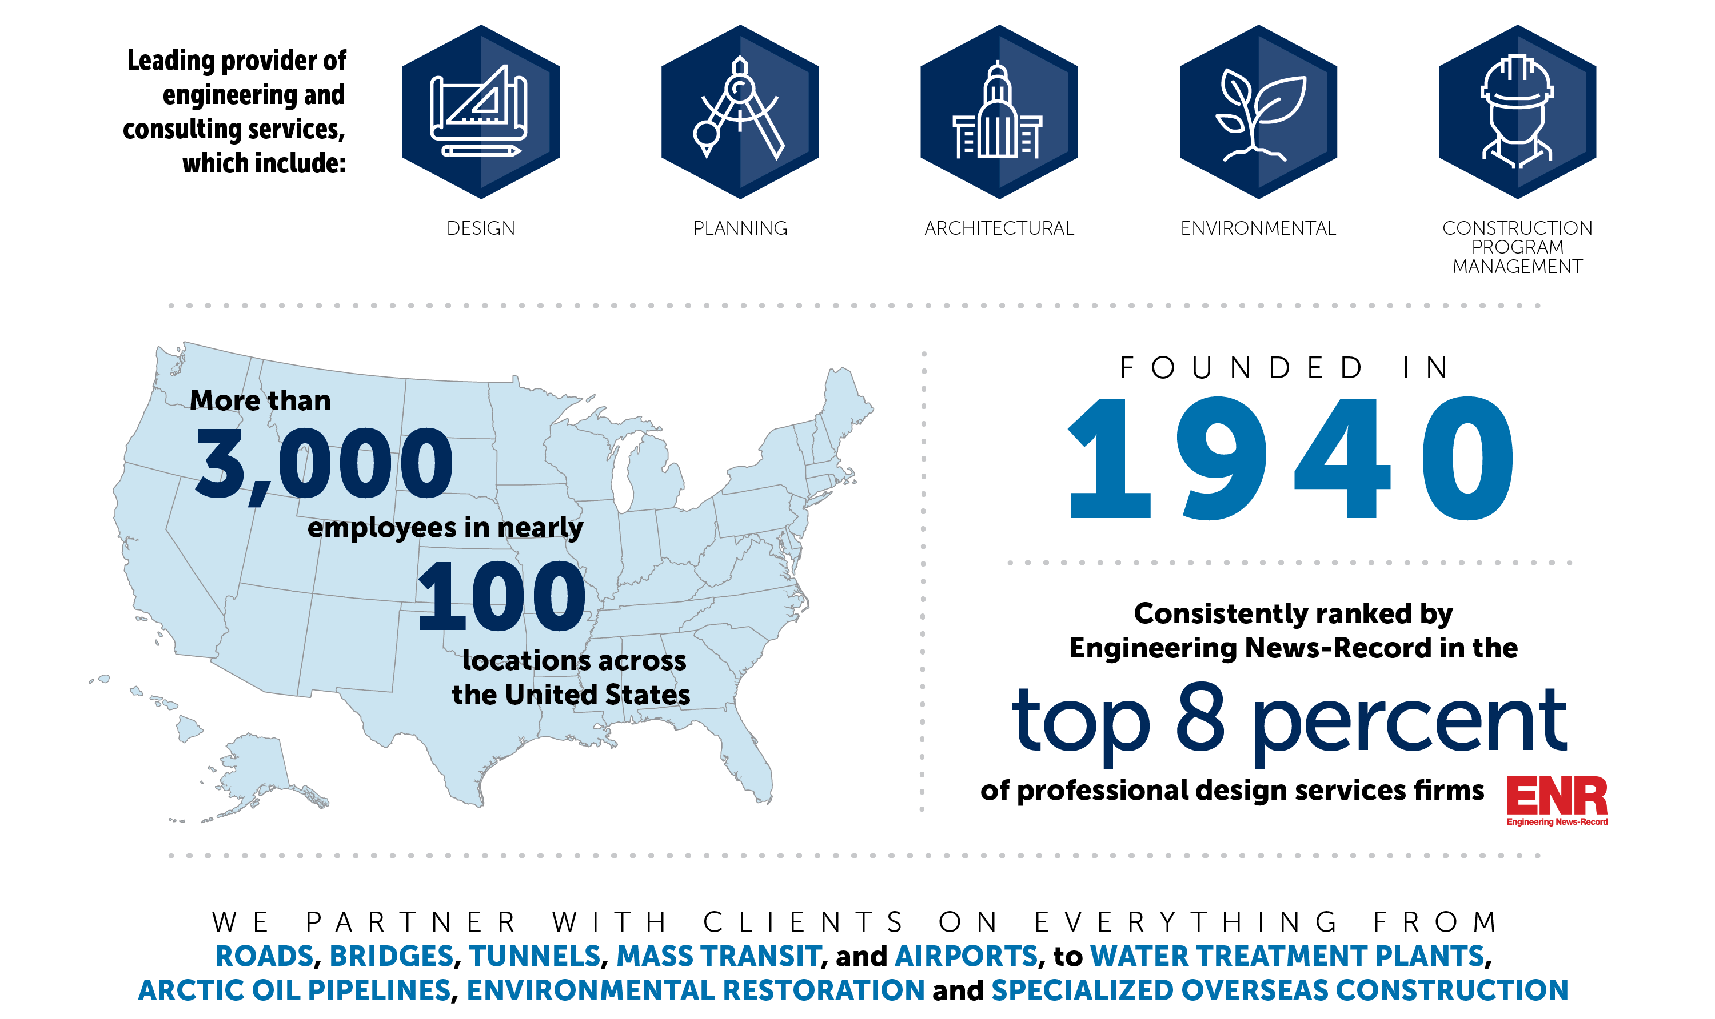
Michael Baker – Fast Facts

Slide 3

What is a Cost Estimate?
A cost estimate is the prediction of the cost of a program, project or operations.
GAO defines it as “the summation of individual cost elements, using established methods and valid data, to estimate the future costs of a program, based on what is known today”.
What is the purpose of a cost estimate?
Cost estimates are used to make decisions and manage risk. The cost estimate along with the project scope and schedule is the foundation of cost management of the project.

Slide 4
AACE 17R-97 Cost Estimate Classifications

Slide 5
High Quality Cost Estimates*
Credible | Well-Documented | Accurate | Comprehensive
Define Characteristics
Determine Structure
Conduct Sensitivity Analysis
Develop Point Estimate
Obtain Data
ID Ground Rules & Exceptions
Risk & Uncertainty Analysis
Document Estimate
Present for Management Approval
Update to Reflect Actuals
Develop Plan
Define Purpose
* GAO Guidance

Slide 6
Characteristics of a Credible Cost Estimate
Estimating Methodology based on the intended use of the estimate
Contracting Strategy and Risk Management are considered
The cost estimate is based upon a project schedule
Develop quantity take off to extent possible to avoid the use of allowances
Prepare the direct cost estimate using appropriate material, labor, equipment, and subcontract pricing (including taxes, shipping, etc.)
Prepare a detailed estimate of indirect cost (home office, OH, etc.)
Include escalation as a separate line item
Allow time for an Independent Review & QC
Compare the estimate against known benchmarks
Prepare cost and schedule risk analysis – Include contingency
Provide a supporting narrative explaining the estimating approach used, major assumptions, and limitations of the cost estimate.

Slide 7

Common Problems
Insufficient time allowance (waiting until the last minute)
Erroneous or optimistic assumptions about the project
Inexperienced cost estimator(s)
Failure to consider key factors that can impact cost and schedule
Failure to understand the scope and specifications
Failure to recognize local practices and cost impacts (market conditions)
Inaccurate cost basis for labor, material, and equipment
Lack of review cycle by knowledgeable, independent cost estimators
Poor quality control
Misapplication of markups
Quantity and/or pricing errors

Slide 8

Best Practices for Cost Estimating Organizations
Establish Cost Estimating Processes & Procedures
Use AACE International, USACE, or similar Standards
Develop and use a Cost Estimating Manual
Develop and use a Quality Control Manual
Invest in Cost Estimator training and resources
Invest in modern “Tools” (software, pricing services, etc.)
Use an Independent Consultant for non-routine (large, complex scope, etc.) projects
Benchmark and Analyze Results

Slide 9
Best Practices – Cost Estimating Techniques
1
Develop a Work Plan for the Estimate
9
Perform a Peer/Quality Control/Quality Assurance Review that is documented
10
Document benchmarks and lessons learned
2
3
4
5
6
7
8
Hold a Kick-Off Meeting with the Team
Use a Standard WBS
Use the technique appropriate for the cost estimate class
Document all Assumptions
Use quotes where practical – use a market survey if possible
Develop a project schedule
Develop a Risk Assessment

Slide 10



Wrap Up – Take Aways
Cost Estimates are Predictions
Estimating Techniques should be based on scope maturity, contracting strategy, risk management, and intended use of the estimate
Cost estimates include assumptions, a schedule, risk assessment
Have a process and follow it. Estimating departments need written procedures and guidelines
Allow time for the independent QC step & document the results
Benchmark and analyze results
Know your limitations and hire an independent consultant when you need one

